Slide 1
1.3 Half-life Objective 3:i
Chemistry

Slide 2
Essential Questions
What is a half-life?
How do you calculate it?

Slide 3
Half Life
The half life of a radioactive material is the amount of time required for ½ of the sample to decay into another element or isotope.
The half life value will not change for a specific isotope

Slide 4
Type 1: Finding final g
Gold-198 has a half-life of 2.7 days. How much of a 96 g sample of gold-198 will be left after 8.1 days?
Step 1: # h.l. = total time/h.l.
8.1/2.7 = 3 h.l.

Slide 5
Type 1: Finding final g (cont)
Step 2: final g = initial g/2^{#h.l.}
96/2³ = 12 g
Or can divide it by 2 for each h.l.
(1 h.l.) 96/2 = 48
(2 h.l.) 48/2 = 24
(3 h.l.) 24/2 = 12

Slide 6
Type 2: Finding Total Time
Thallium-208 has a half-life of 3.053 min. How long will it take for 120.0 g to decay to 7.50 g?
Step 1: Divide initial g by 2 until it equals final g
120.0/2 = 60.0/2 = 30.0/2 = 15.0 g/2 = 7.5 g
Therefore the sample has halved 4 times, or gone through 4 half-lives.

Slide 7
Type 2: Finding Total Time (cont)
Step 2: Total time = # h.l. x h.l.
4 x 3.053 =12.21 min

Slide 8
Type 3: Finding Half-life
If 100.0 g of carbon-14 decays until only 25.0 g of carbon is left after 11,460 y, what is the half-life of carbon-14?
Step 1: Divide initial g by 2 until it equals final g
100.0/2 = 50.0/2 = 25.0
Two half-lives have passed.

Slide 9
Type 3: Finding Half-life (cont)
Step 2: h.l. = total time/# h.l.
11,460/2 = 5,730 years

Slide 10
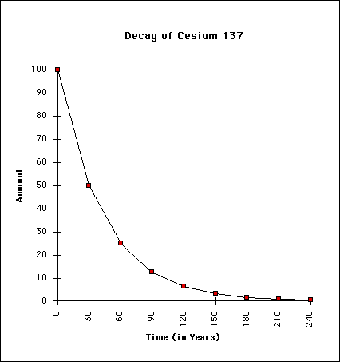
Half Life (cont)
What would the half life be of cesium-137?
How much remains after 5 half-lifes?
At what time is there 20 g left?

Slide 11
Essential Questions
What is a half-life?
How do you calculate it?

Slide 12
1.3 Tracked Assignment
Worksheet

