Slide 1
2.1 History of the Atom Objectives 1; 5:a
Chemistry

Slide 2
Essential Questions
What are the different atomic models and what do they look like?
What were the experiments that Thomson and Rutherford did?
What is the current model of the atom and what does it look like?

Slide 3
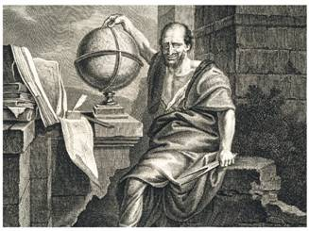
Democritus
Democritus (460 -370 BC) was the first to propose the idea of an atom and said that atoms were indivisible, indestructible, and make up everything
Don’t need to write: Atom comes from the Greek word atomos

Slide 4
Experimental evidence for new theory (don’t need to know)
Law of conservation of mass. Mass is neither created or destroyed in a chemical reaction.
The law of Definite proportions. The proportion by mass of the elements in a given compound is always the same.
The law of Multiple proportions. When two elements form compounds The ratio of their masses always form small whole numbers. Example, CO or CO₂.

Slide 5
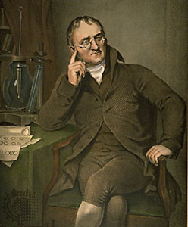
John Dalton’s Atomic Theory
John Dalton combined Democritus ideas with the previously listed laws to come up with his own atomic theory.
All elements are composed of small indivisible particles called atoms

Slide 6
John Dalton’s Atomic Theory
Atoms of the same element are unique to that element and different than any other element.
Atoms of different elements can physically mix together or can chemically combine in simple whole-number ratios to form compounds.
During a chemical reaction the elements are neither changed, created, or destroyed

Slide 7
Discovery of Proton
In 1886, Eugen Goldstein discovered in a cathode-ray tube there are rays that travel in the opposite direction of the cathode rays composed of positive particles.
Such positively charged subatomic particles are called protons.

Slide 8
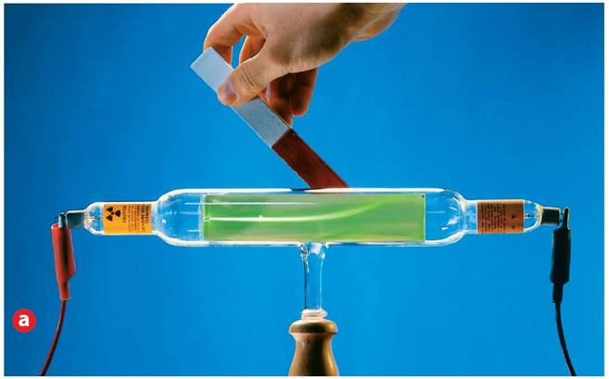
Discovery of the Electron
In 1897 J.J. Thomson discovered the electron when he found that a cathode ray is deflected (bent) by a positive magnet.
The cathode ray was made up of negatively charged electrons.

Slide 9
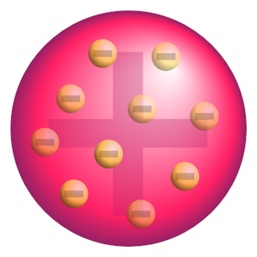
Thomson Model
Thomson created the plum pudding model after discovering the e⁻ with the cathode ray.
Plum pudding model is a positive sphere with negative electrons spread throughout

Slide 10
Rutherford’s Model
Rutherford wanted to test Thomson’s model by shooting alpha particles through gold foil
Rutherford expected the alpha particle to go through with slight deflection
Most of the particles went straight through and some came straight back at the source

Slide 11
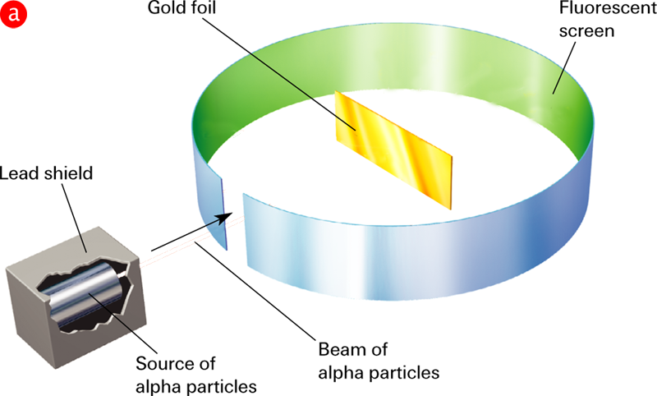
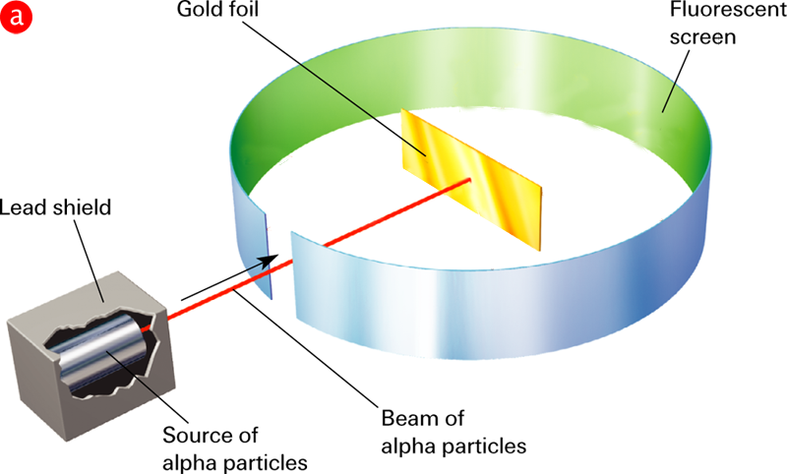
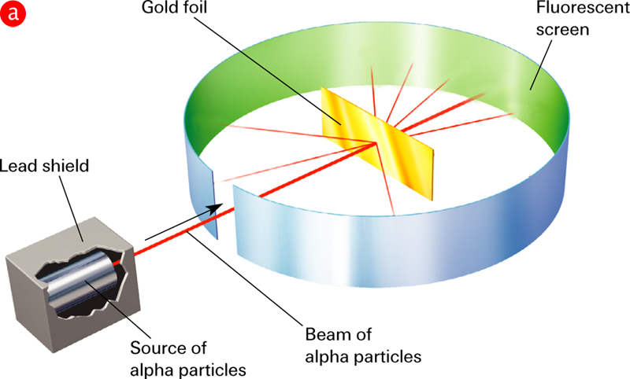
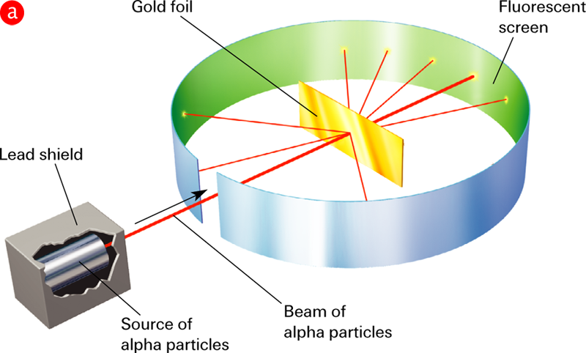
Rutherford’s Model (cont)
Rutherford’s Gold-Foil Experiment
Notes:
Rutherford’s gold-foil experiment yielded evidence of the atomic nucleus. a) Rutherford and his coworkers aimed a beam of alpha particles at a sheet of gold foil surrounded by a fluorescent screen. Most of the particles passed through the foil with no deflection at all. A few particles were greatly deflected. b) Rutherford concluded that most of the alpha particles pass through the gold foil because the atom is mostly empty space. The mass and positive charge are concentrated in a small region of the atom. Rutherford called this region the nucleus. Particles that approach the nucleus closely are greatly deflected.

Slide 12
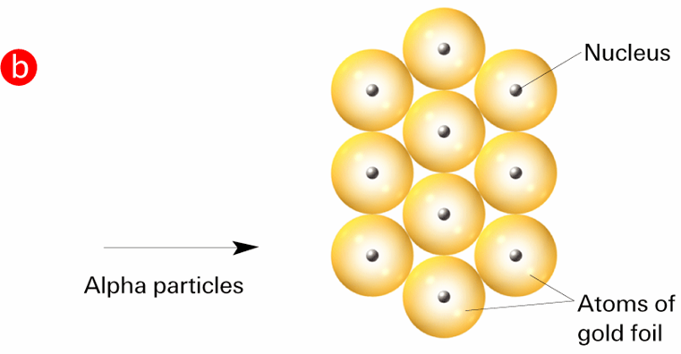
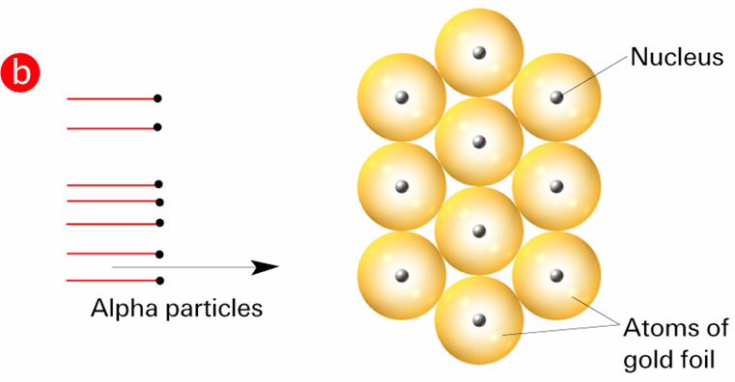
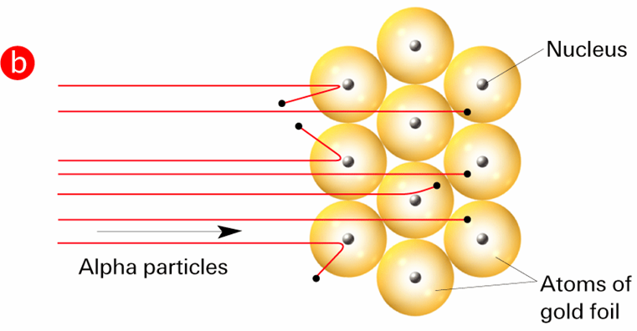
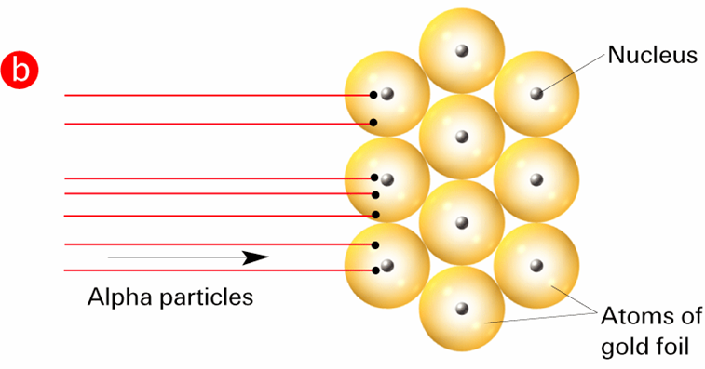
Rutherford’s Model (cont)
Alpha particles scatter from the gold foil.
Notes:
Rutherford’s gold-foil experiment yielded evidence of the atomic nucleus. a) Rutherford and his coworkers aimed a beam of alpha particles at a sheet of gold foil surrounded by a fluorescent screen. Most of the particles passed through the foil with no deflection at all. A few particles were greatly deflected. b) Rutherford concluded that most of the alpha particles pass through the gold foil because the atom is mostly empty space. The mass and positive charge are concentrated in a small region of the atom. Rutherford called this region the nucleus. Particles that approach the nucleus closely are greatly deflected.

Slide 13
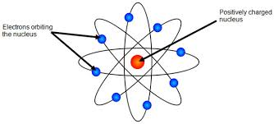
Rutherford’s Model (cont)
Rutherford created a model that is mostly empty space where the electrons orbit randomly around the nucleus in the center.

Slide 14
Rutherford’s Model (cont)
The nucleus is the tiny central core of an atom and is composed of protons and neutrons.
The nucleus is a small positively charged region that contains almost all of the atom’s mass

Slide 15
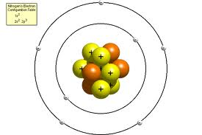
Bohr Model
Bohr model has a nucleus with protons and neutrons with electrons going on orbits around the nucleus
Each orbit exists at a fixed energy level and takes a fixed path

Slide 16
Quantum Mechanical Model
The current model of the atom is the Quantum Mechanical Model based on the work of Schrodinger
The Quantum Mechanical Model has a nucleus with protons and neutrons with electrons in orbitals around the nucleus

Slide 17
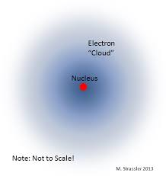
Quantum Mechanical Model (cont)
Orbitals are areas with a high likelihood of having an electron and exist at fixed energy levels

Slide 18
Discovery of Neutron
In 1932, James Chadwick discovered the neutron.
Neutrons are subatomic particles with no charge but with a mass nearly equal to that of a proton.

Slide 19
Part of the Atom (review)
Subatomic Particle | Symbol | Relative Charge | Location in Atom | Relative Mass (amu)
Proton | p⁺ | 1+ | Nucleus | 1
Neutron | n⁰ | 0 | Nucleus | 1
Electron | e⁻ | 1- | Orbitals | 0

Slide 20
Essential Questions
What are the different atomic models and what do they look like?
What were the experiments that Thomson and Rutherford did?
What is the current model of the atom and what does it look like?

Slide 21
2.1 Assignment
p 103 # 1, 4-5
p 108 #9, 12-14
p 122 # 39, 40, 42, 44, 61, 70, 74, 77

