Slide 1
2.2 Light Objectives 2:a; 3; and 4:b
Chemistry

Slide 2
Essential Questions
What properties does light have?
What is the relationship between wavelength and frequency?
How do you identify the type of radiation using frequency or wavelength?
What is an atomic spectrum and what does it tell us?

Slide 3
Light
Light is radiant energy and has the same properties as a wave
The amplitude of a wave is the wave’s height from zero to the crest.
The wavelength, λ, is the distance between the crests.
The unit is m, but nm is often used for visible light
The frequency, ν, is the number of wave cycles to pass a given point per unit of time.
The unit is hertz (Hz) or s⁻¹

Slide 4
Light (cont)
The wavelength and frequency of light are inversely proportional to each other so when one increases the other must decrease
Notes:
The frequency and wavelength of light waves are inversely related. As the wavelength increases, the frequency decreases.

Slide 5
Light (cont)
Light is made up of electromagnetic waves.
Electromagnetic radiation includes radio waves, microwaves, infrared waves, visible light, ultraviolet waves, X-rays, and gamma rays.
In the visible spectrum, red light has the longest wavelength and the lowest frequency.

Slide 6
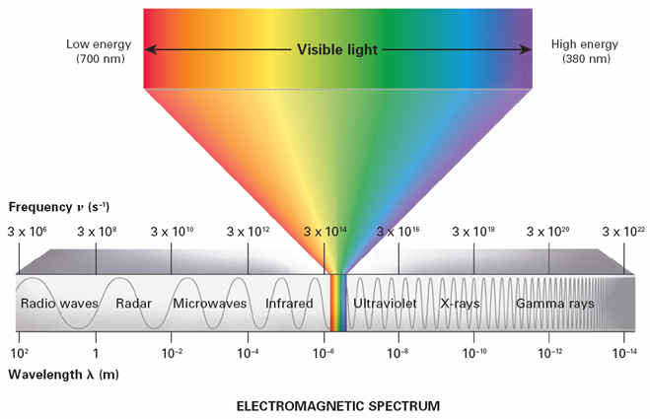
Light (cont)
Electromagnetic Spectrum (p 139)
Notes:
The electromagnetic spectrum consists of radiation over a broad band of wavelengths. The visible light portion is very small. It is in the 10⁻⁷m wavelength range and 10¹⁵ Hz (s⁻¹) frequency range. Interpreting Diagrams What types of nonvisible radiation have wavelengths close to those of red light? To those of blue light?

Slide 7
Light (cont)
The product of the frequency and wavelength always equals a constant (c), the speed of light.
The speed of light equals 3.00x10⁸ m/s
All electromagnetic waves travel in a vacuum at a speed of 3.00 × 10⁸ m/s.

Slide 8
Light (cont)

Slide 9
Light Practice (cont)
In what range of the spectrum is a wavelength of 5.00 x 10⁻⁸ m?
What is type of radiation when the frequency of the wave is 2.4x10¹⁰ Hz?
What is the type of radiation for a frequency of 3.83 x 10¹⁰ s⁻¹?
What is the type of radiation for a wavelength of 8.51 x 10⁻³ m?

Slide 10
Light Practice (cont)
Would you expect a large or small wavelength if the frequency is large? Why?
Small because as frequency gets larger wavelength gets smaller
Describe the relationship between wavelength and frequency.
As one increases the other value must decreases
Put the following in order of increasing frequency: gamma, uv, x-ray
uv, x-ray, gamma

Slide 11
Atomic Spectra
The atomic emission spectrum is the pattern of discrete lines formed from the frequencies of light emitted by an element.
All elements have an unique spectrum from having different arrangement of electrons

Slide 12
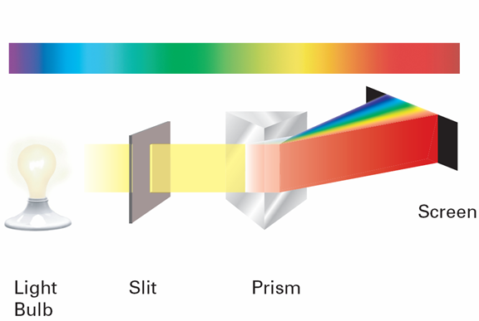
Atomic Spectra (don’t need to write)
When white light passes through a prism, it produces a continuous rainbow of colors.
Notes:
A prism separates light into the colors it contains. For white light this produces a rainbow of colors.

Slide 13
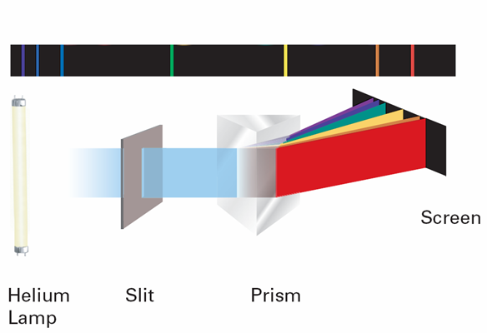
Atomic Spectra (don’t need to write)
When light from a helium lamp passes through a prism, individual colored lines are produced.
Notes:
A prism separates light into the colors it contains. Light from a helium lamp produces discrete lines. Identifying Which color has the highest frequency?

Slide 14
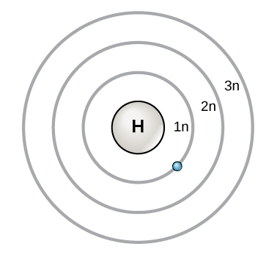
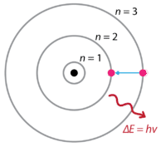
Atomic Spectra (cont)
What causes atomic emission spectrums?
When atoms absorb energy, e⁻ move into higher energy levels. These e⁻ then lose energy by emitting light when they return to lower energy levels which are seen as lines.
E
E
Absorption
Emission

Slide 15
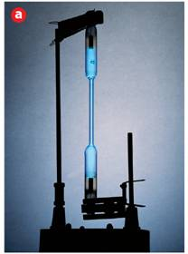
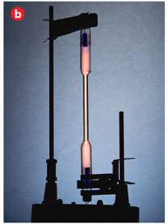
Atomic Spectra
Mercury
Nitrogen
Notes:
No two elements have the same emission spectrum. a) Mercury vapor lamps produce a blue glow. b) Nitrogen gas gives off a yellowish-orange light.

Slide 16
Essential Questions
What properties does light have?
What is the relationship between wavelength and frequency?
How do you calculate frequency and wavelength?
What is an atomic spectrum and what does it tell us?

Slide 17
2.2 Tracked Assignment
P 146 #16-17, 21
P 149 #41, 44, 45, 47, 55 (only b), 56 (only c), 58

