Slide 1
2.3 Modern Atomic Structure Objectives 1:c; 2; 4:b; 5:a-b

Slide 2
Essential Questions
What is a photon?
What is the relationship between energy and frequency? Energy and wavelength?
How do electrons change energy levels?
What is the current model of the atom? What does it look like?
What is the difference between orbits and orbitals?
What are the different types of orbitals?

Slide 3
Energy
Max Planck determines that light is NOT a continuous beam of energy, but a beam of fixed amounts of energy
Fixed amounts can be called quantum
Energy is like a stair case increasing and decreasing in set amounts
E
E
E
E

Slide 4
Photoelectric effect
When light with a high enough frequency shines on metal, electrons are ejected.

Slide 5
Photoelectric effect (cont)
Einstein explained the photoelectric effect by proposing that the light has a dual nature where it acts as both a particle and a wave.
Light is made of photons which is a quantum of light with properties of a particle.

Slide 6
Photoelectric effect (cont)

Slide 7
Photoelectric effect (cont)
Einstein showed the proportional relationship between light’s frequency and energy with the following equation:
E = hν
Where E is energy, ν is frequency and h is Planck’s constant 6.63 x 10⁻³⁴ J*s

Slide 8
Color of Photons Emitted
ROY G BIV
Energy/frequency Increases
Wavelength decreases
Lowest energy photons are red because they have the lowest frequency
Highest energy photons are violet because they have the highest frequency

Slide 9
Energy of Photons
Describe the relationship between energy and frequency of light.
Proportional or as frequency goes up so does energy
Describe the relationship between energy and wavelength of light.
Inversely proportional or as wavelength increases energy decreases
Which would have more energy Blue or Yellow photons? Why?
Blue because it has a greater frequency so it’ll have greater energy

Slide 10
Energy of Photons (cont)
Photon A has a frequency of 7.60 x 10⁶ s⁻¹ and photon B has a frequency of 4.3 x 10¹¹ s⁻¹. Which photon of light would have more energy and why?
Photon B because it has a greater frequency so it’ll have greater energy
Which would have a higher amount of energy, a wave with a frequency of 5.42 x 10¹⁵ Hz or one with a frequency of 3.00 x 10²¹ Hz?
3.00 x 10²¹ Hz; greater frequency so it’ll have greater energy

Slide 11
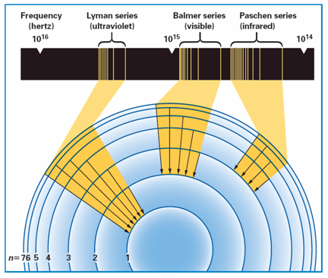
The Bohr Model (don’t need to know)
Bohr’s model showed that the three groups of lines in the hydrogen spectrum corresponded to the transition of e⁻ from higher energy levels to lower energy levels.
Notes:
The three groups of lines in the hydrogen spectrum correspond to the transition of electrons from higher energy levels to lower energy levels. The Lyman series corresponds to the transition to the n = 1 energy level. The Balmer series corresponds to the transition to the n = 2 energy level. The Paschen series corresponds to the transition to the n = 3 energy level.

Slide 12
The Bohr Model (cont)
Bohr model is based on atomic emission spectra where the different lines correspond to an electron making a specific change in energy levels.
Which is why in the Bohr model each electron is in a fixed orbit that exists at a fixed energy level around the nucleus.

Slide 13
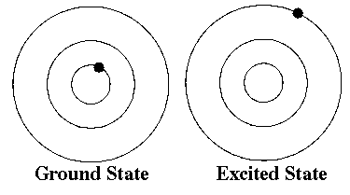
The Bohr Model (cont)
When the electron is in its lowest possible energy level, the electron is in its ground state
Any state that is above the ground state in energy is called an excited state

Slide 14
The Bohr Model (cont)
Absorbing energy raises the electron from the ground state to an excited state.
The energy absorbed has to be a quantum of energy dependent on the change in energy level
A photon is then emitted when the electron drops back to a lower energy level.

Slide 15
The Bohr Model (cont)
1, 4, and 5 show the absorption of a photon.
2 shows emission of a photon of energy.
3 would not happened because electrons must be on an energy level
1 is absorbing more energy than 4 and 5
If 5 absorbed an orange photon you would expect 4 to absorb a red photon
n represents the energy level
n = 5
n = 4
n = 3
n = 2
n = 1

Slide 16
Matter Waves
Louis de Broglie said that electrons could be considered waves confined to the space around an atomic nucleus.
The electron waves could exist only at specific frequencies that corresponded to the quantized energies of Bohr’s orbits.

Slide 17
Heisenberg Uncertainty Principle
The Heisenberg uncertainty principle states that it is impossible to determine simultaneously (at the same time) both the position and velocity of an electron or any other particle.
You can only know the velocity or the position not both

Slide 18
The Quantum Mechanical Model
The quantum mechanical model is based on the work of Erwin Schrödinger and is the current model of the atom
The quantum mechanical model has electrons in orbitals around the nucleus
An orbital is the region of space in which there is a high probability of finding an electron.
There are 4 types of orbitals: s, p, d, and f

Slide 19
The Quantum Mechanical Model (don’t need to know)
The propeller blade has the same probability of being anywhere in the blurry region, but you cannot tell its location at any instant. The electron cloud of an atom can be compared to a spinning airplane propeller.
Notes:
The electron cloud of an atom is compared here to photographs of a spinning airplane propeller. a) The airplane propeller is somewhere in the blurry region it produces in this picture, but the picture does not tell you its exact position at any instant. b) Similarly, the electron cloud of an atom represents the locations where an electron is likely to be found.

Slide 20
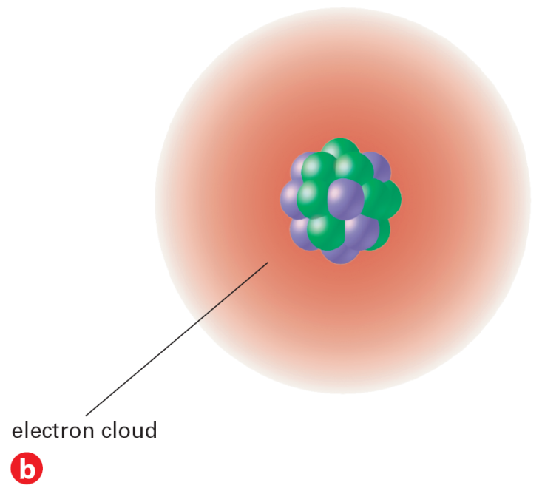
The Quantum Mechanical Model
This is the current model of the atom and is shown as an electron cloud
The electron cloud shows the probability of finding an electron in a given location. The denser the cloud is the more likely an electron will be in that location
Notes:
The electron cloud of an atom is compared here to photographs of a spinning airplane propeller. a) The airplane propeller is somewhere in the blurry region it produces in this picture, but the picture does not tell you its exact position at any instant. b) Similarly, the electron cloud of an atom represents the locations where an electron is likely to be found.

Slide 21
Atomic Orbitals (don’t need to know)
Different atomic orbitals are denoted by letters. The s orbitals are spherical, and p orbitals are dumbbell-shaped.
Notes:
The electron clouds for the s orbital and the p orbitals are shown here.

Slide 22
Atomic Orbitals (don’t need to know)
Four of the five d orbitals have the same shape but different orientations in space.
Notes:
The d orbitals are illustrated here. Four of the five d orbitals have the same shape but different orientations in space. Interpreting Diagrams How are the orientations of the d_{xy} and d_{x}² – _{y}² orbitals similar? How are they different?

Slide 23
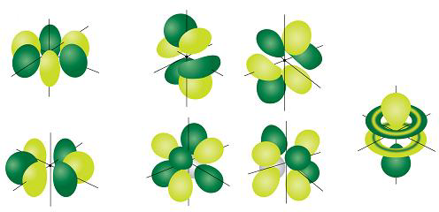
Atomic Orbitals (don’t need to know)
There are seven f orbitals

Slide 24
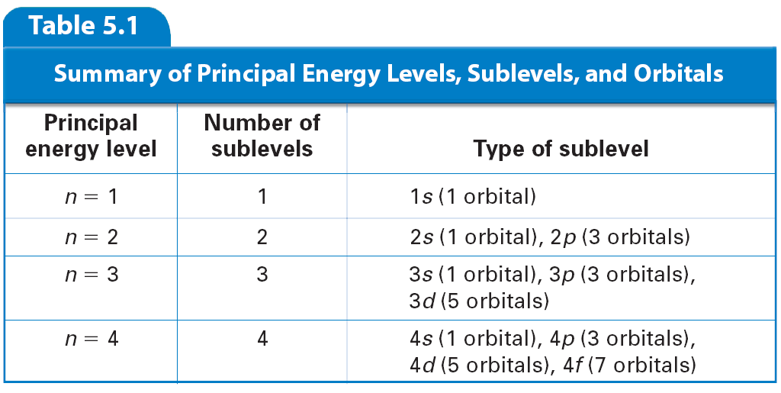
Atomic Orbitals (don’t need to know)
The numbers and kinds of atomic orbitals depend on the energy sublevel.

Slide 25
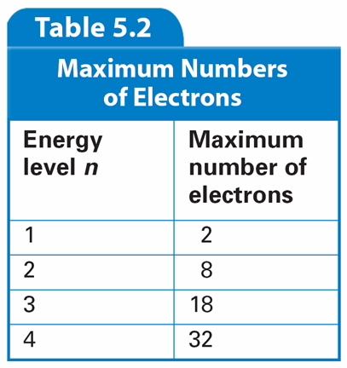
Atomic Orbitals (don’t need to know)
The number of electrons allowed in each of the first four energy levels are shown here.

Slide 26
Essential Questions
What is a photon?
What is the relationship between energy and frequency? Energy and wavelength?
How do electrons change energy levels?
What is the current model of the atom? What does it look like?
What is the difference between orbits and orbitals?
What are the different types of orbitals?

Slide 27
2.3 Tracked Assignment
Worksheet

