Slide 1
2.4 Electron Configuration Objective 5:b-c
Chemistry

Slide 2
Essential Questions
What is an electron configuration?
What is the Aufbau Principle?
How do you write standard electron configuration and noble gas electron configuration?

Slide 3
Atomic Orbitals
Principle energy levels are made up of sublevels
Sublevels are made up of orbitals
Each orbital can hold a maximum of 2 electrons
Each energy sublevel corresponds to an orbital of a different shape and type
Recall: The types are s, p, d, and f

Slide 4
Electron Configuration
Electron configuration is the arrangement of electrons in an atom
The two types of electron configuration is standard electron configuration and noble gas electron configuration.
Standard will have the full configuration and noble gas will be shortened using the noble gasses from column 18

Slide 5
Electron Configuration (cont)
Orbitals come in the following sets:
1 of s, 3 of p, 5 of d, and 7 of f
Maximum electrons for each is 2 for s, 6 for p, 10 for d, and 14 for f
The orbitals listed in order of increasing energy would be s, p, d, and f.
The number in front of the orbital is the energy level so 1s means an s orbital on energy level 1

Slide 6
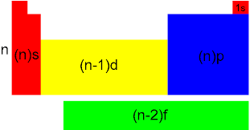
Blocks of the Periodic Table
n represents row number
Will not have to write any with f

Slide 7
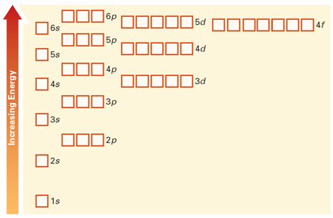
Aufbau Principle
Aufbau Principle states electrons enter the lowest available energy orbital first so standard will always start with 1s

Slide 8
Examples
Nitrogen
Standard electron configuration : 1s² 2s² 2p³
Noble Gas electron configuration : [He] 2s²2p³
Sulfur
Standard electron configuration : 1s² 2s² 2p⁶3s²3p⁵
Noble Gas electron configuration : [Ne] 3s²3p⁵

Slide 9
Examples
Nickel
Standard electron configuration : 1s² 2s² 2p⁶3s²3p⁶4s²3d⁸
Noble Gas electron configuration : [Ar] 4s²3d⁸
Rubidium
Standard electron configuration : 1s² 2s² 2p⁶3s²3p⁶4s²3d¹⁰4p⁶5s¹
Noble Gas electron configuration : [Kr] 5s¹

Slide 10
Video

Slide 11
Essential Questions
What is an electron configuration?
What is the Aufbau Principle?
How do you write standard electron configuration and noble gas electron configuration?

Slide 12
2.4 Tracked Assignments
Worksheet

