Slide 2
3.1 Periodic Table and Periodic Trends
Chemistry
Objectives 1:a-b, d-e; 3

Slide 3
Essential Questions
Why do we use the periodic table?
How is the periodic table arranged?
Why do groups share properties?
What are valence electrons?
What are the different periodic trends and how do they change going across and down the periodic table?

Slide 4
Periodic Table
Why do we have a periodic table?
The periodic table provides a way for organizing elements
Why does this matter?
The periodic table tells us what properties an element will have

Slide 5
History of the Periodic Table (don’t need to know)
The first periodic table was based off of the work of Mendeleev
Mendeleev arranged the elements in his periodic table in order of increasing atomic mass and grouped them according to properties.

Slide 6
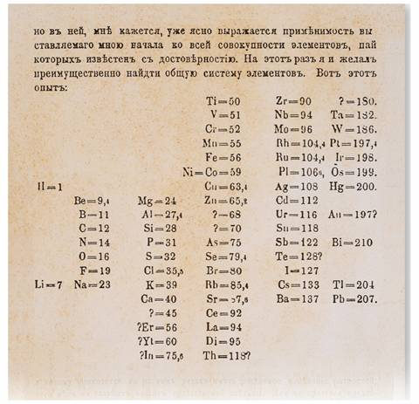
History of the Periodic Table (cont) (don’t need to know)
The elements were grouped in columns
He even left places for undiscovered elements.
Look at Ar, Ca, and K what do you notice?

Slide 7
Periodic Table Arrangement
How is the current periodic table arranged?
Atomic number
Moseley arranged the periodic table by atomic number so that elements with the same properties fall into the same column

Slide 8
Periodic Table Arrangement (cont)
The vertical columns of the periodic table are called groups or families
The horizontal rows of the periodic table are called periods

Slide 9
Group Properties
The elements in the same group share similar properties from having the same valence electrons
Valence electrons determine an element’s chemical properties

Slide 10
Valence Electrons
Valence electrons are “outer shell” or outer energy level electrons
How do you know how many valence electrons there are?
Counting the number of columns (not including d block)
Carbon would have 4 valence electrons
How many would Oxygen have?
6

Slide 11
Period Properties
The properties of the elements change as you move across a period from left to right.
Elements in the same period will have valence electrons in the same valence shell or energy level

Slide 12
Periodic Trends: Radius
Atomic radius is the distance from the center of the nucleus to the outermost electron

Slide 13
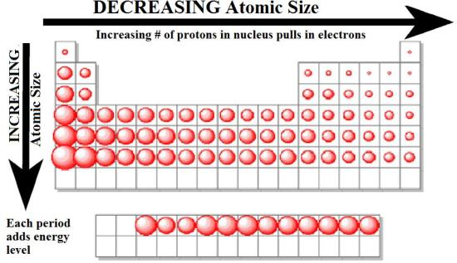
Periodic Trends: Radius (cont)
Atomic radii decreases as you move from left to right across the periodic table and increases as you go down the periodic table

Slide 14
Periodic Trends: Radius (cont)
Increases going down because of the addition of e⁻ shells (filling a new energy level/valence shell)
Decreases going across because of the increased attractions between nucleus and e⁻ from adding p⁺
Changes going across rows are smaller than changes going down columns

Slide 15
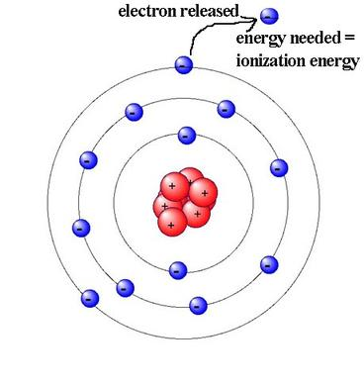
Periodic Trends: IE
Ionization energy (IE) is the energy required to remove an e⁻
Ionization energy increases as you move from left to right across the periodic table and decreases as you go down the periodic table

Slide 16
Periodic Trends: IE (cont)
The IE increases going across because as the radius decreases this strengthens the attraction between the nucleus and the e⁻ so it requires more energy to remove an e⁻
The IE decreases going down because as the radius increases this weakens the attraction making it require less energy to remove an e⁻

Slide 17
Periodic Trends: Electroneg
Electronegativity measures the ability of an atom to attract electrons from another atom in a compound.
Electronegativity increases as you move from across the periodic table and decreases as you go down the periodic table except column 18

Slide 18
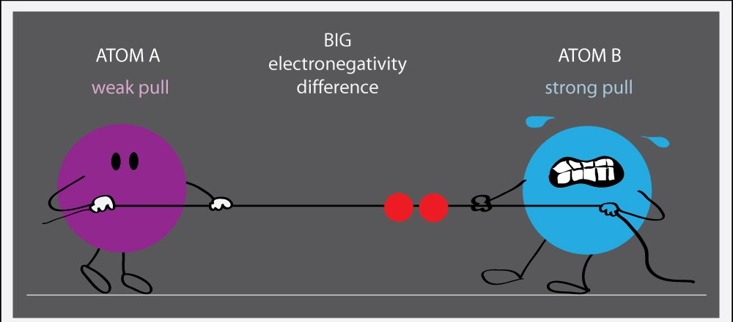
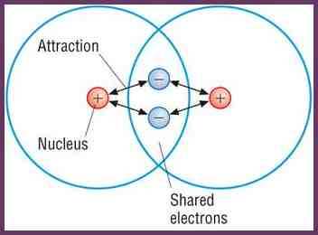
Periodic Trends: Electroneg (cont)

Slide 19
Periodic Trends: Electroneg (cont)
Column 18 equals 0 because their full valence shell means they normally do not bond
Electronegativity increases going across because the smaller radius strengthens the attraction between the nucleus and the e⁻ making it easier to attract new electrons
Electronegativity decreases going down groups because the larger radius weakens the attraction making it harder to attract new electrons

Slide 20
Periodic Trends: Practice
Is Te or S larger for the following:
Ionization energy
Electronegativity
Radius
Is Au or Po larger for the following:
Ionization energy
Electronegativity
Radius
S
S
Te
Po
Po
Au

Slide 21
Periodic Trends: Practice (cont)
Explain why Ta would have a bigger radius than Tl
Tl has more p⁺ so stronger attraction to e⁻
Explain why P has larger ionization energy (IE) than Te
P has a smaller radius so greater attraction to e⁻ more energy is required to remove it

Slide 22
Periodic Trends: Practice (cont)
Explain why Ba has a lower electronegativity than Mg
Ba has a larger radius so a weaker attraction to new e⁻

Slide 23
Essential Questions
Why do we use the periodic table?
How is the periodic table arranged?
Why do groups share properties?
What are valence electrons?
What are the different periodic trends and how do they change going across and down the periodic table?

Slide 24
3.1 Tracked Assignment
p 160 # 3, 5, 7
p 178 # 16, 18, 20, 22, 23
p 181-182 #27, 36, 38, 39, 43, 46 (not d) 49, 50, 61(not b), 62

