Slide 2
3.2 Types of Elements and the Groups of the Periodic Table
Chemistry
Objectives 1:c,e; 2

Slide 3
Essential Questions
What are the types of elements and how can you tell what type an element is?
What are the properties of metals, nonmetals, and metalloids?
What are the different groups on the periodic table and what properties do they have?
Why do elements in the same group have similar properties?

Slide 4
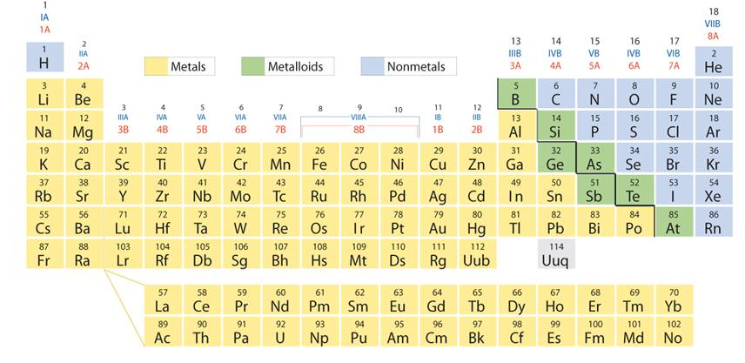
Types of Elements
What are the three types of elements?
Metals, nonmetals, and metalloids/semimetals

Slide 5
Location of the Types of Elements
Metals are to the left of the stairs (except H) and make up 80% of all elements
Nonmetals are found to the right of the stairs plus H
Metalloids are along the stairs (except Al and Po which are metals)

Slide 6
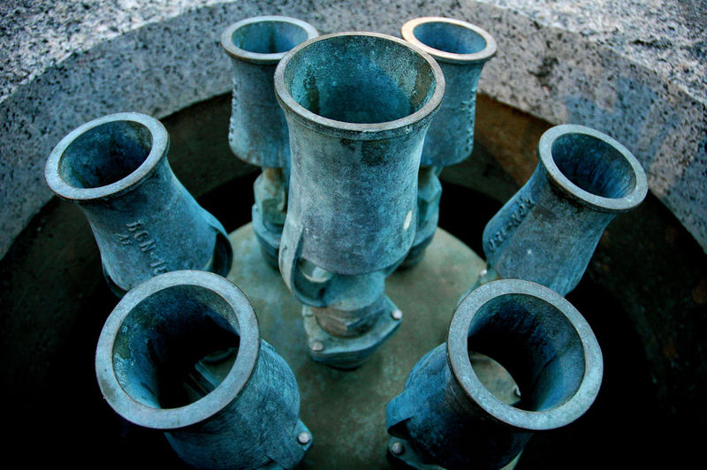
Metals
Metals have the following properties:
High melting point so solids at room temperature (except Hg)
Good conductors of heat and electricity.
Lustrous - shiny
Ductile - can be made into wires
Malleable – can be made into sheets
Many react with acids

Slide 7
Nonmetals
Nonmetals have the following properties:
Generally low melting point so most nonmetals are gases but they come in all 3 states
Dull (not shiny)
Brittle (shatters when hit)
Most are poor conductors and do not react with acid

Slide 8
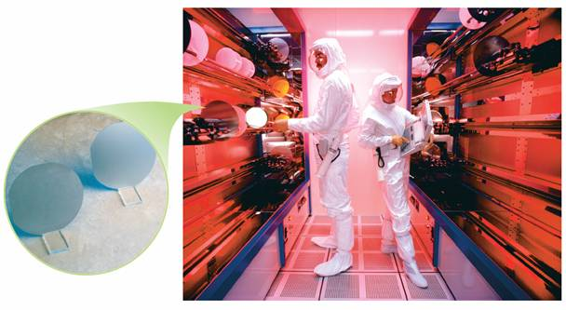
Metalloids
Metalloids will have properties of both metals and nonmetals which vary depending on the metalloid.

Slide 9
Trends
As you move across the periodic table the elements are becoming less metallic and more nonmetallic
Moving down the periodic table elements become more metallic and less nonmetallic
Elements near the staircase have a mixture of both types of characteristics

Slide 10
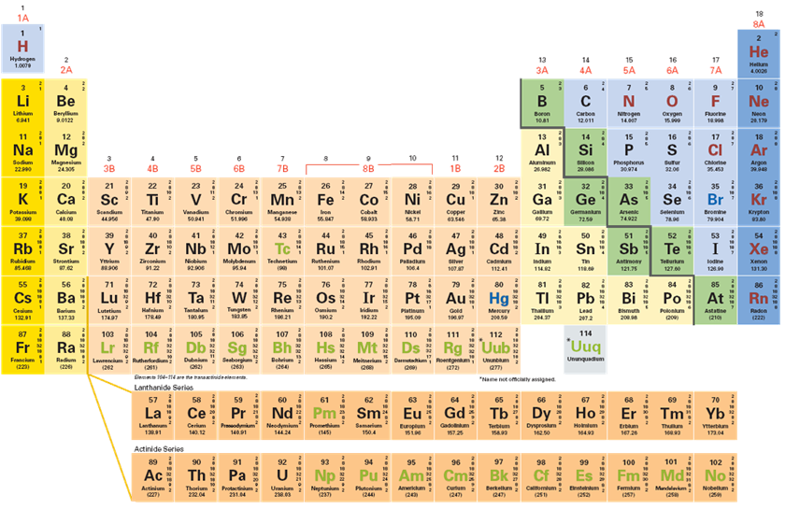
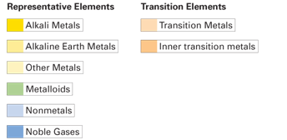
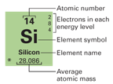
Groups of the Periodic Table
Notes:
In this periodic table, the colors of the boxes are used to classify representative elements and transition elements.

Slide 11
Groups of the Periodic Table
There are several main groups of the periodic table
They are the alkali metals, alkaline earth metals, transition metals, halogens, and noble gases
They have properties in common because of their same valence electrons

Slide 12
Alkali Metals
In atoms of the Group 1 (1A) elements below, there is only one valence electron in the highest occupied energy level.

Slide 13
Alkali Metals
Alkali metals are soft, silver in color, shiny, good conductors, and highly reactive
Alkali metals are so reactive they must be stored in oil and are highly reactive with water.
Reactivity increases as you go down the periodic table due to decreasing first ionization energy

Slide 14
Alkaline Metals
Alkaline metals are group 2 (2A)
They have 2 valence electrons in their s orbital
They are shiny, silver, good conductors, and reactive
They are reactive, but not as reactive as alkali metals

Slide 15
Transition Elements
6.2
There are two types of transition elements—transition metals and inner transition metals.
Transition metals are in the d block
Inner transition metals are in the f block
They have the same properties as metals (see metal description), but properties can vary throughout the whole group

Slide 16
Halogens
Group 17 (7A) are the halogens and have 7 valence electrons
The halogens are nonmetals, come in all 3 states, and are highly reactive
Reactivity decreases as you go down due to decreasing electronegativity

Slide 17
Noble Gases
6.2
The noble gases are the elements in Group 18 (8A) of the periodic table. They have full valence shells of 8 except for He which has a full shell of 2.

Slide 18
Noble Gases (cont)
The noble gases are nonreactive (inert), nonmetals, colorless, odorless, and gases.
They are nonreactive (except some with F) because of their full valence electron shell

Slide 19
Essential Questions
What are the types of elements and how can you tell what type an element is?
What are the properties of metals, nonmetals, and metalloids?
What are the different groups on the periodic table and what properties do they have?
Why do elements in the same group have similar properties?

Slide 20
3.2 Tracked Assignment
p 160 #4, 6
p 167 #12, 14, 15
p 181-182 #28-30, 32, 33, 48, 51, 54

