Slide 1
4.2 Metallic Bonding Objectives
Chemistry

Slide 2
Essential Questions
What is metallic bonding?
What is a sea of electrons?
How do metallic bonds achieve the octet rule?
What properties do metals have?
Why do metals have the properties they do?

Slide 3
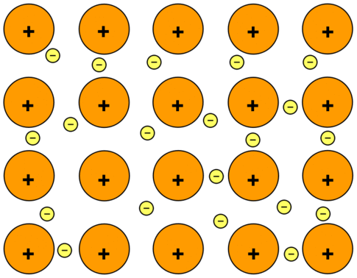
Metallic Bonds
Metallic bond is the attraction between the metal cations to the delocalized valence electrons/sea of electrons.
In a sea of electrons the valence electrons are mobile and can drift freely from one part of the metal to another.

Slide 4
Metallic Bonds (cont)
How do metallic bonds achieve the octet rule?
The delocalized valence electrons/sea of electrons.
How does electronegativity affect metallic bonds?
The low electronegativity values of metals means that metals have a weak hold on their valence electrons which is why the electrons are mobile and move freely rather than staying with one atom

Slide 5
Metallic Compound Properties
The properties of a metallic compound:
Crystalline structures
Insoluble (do not dissolve well in water)
High melting point
Malleable (can be shaped into sheets)
Ductile (can be shaped into wires)
Good conductors of heat and electricity
Shiny/lustrous

Slide 6
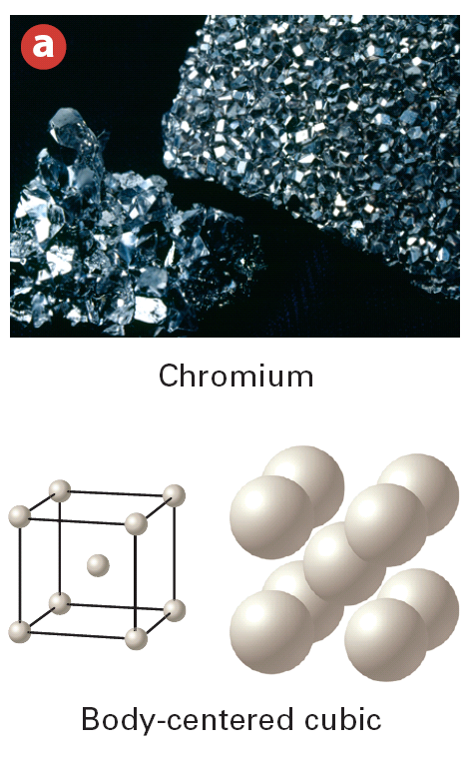
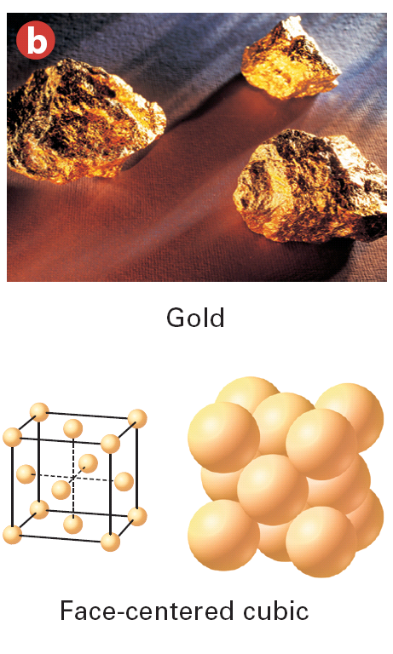
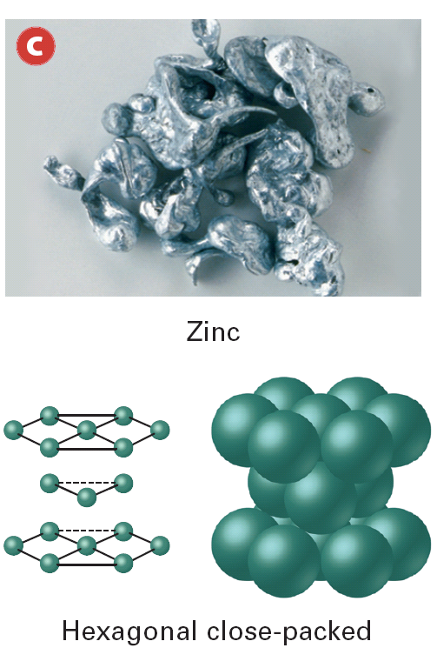
Crystalline Structure of Metals (don’t need to write)
Metal atoms are arranged in a crystalline structure with very compact and orderly patterns.
Notes:
Metal atoms crystallize in characteristic patterns. a) Chromium atoms have a body-centered cubic arrangement. b) Gold atoms have a face-centered cubic arrangement. c) Zinc atoms have a hexagonal close-packed arrangement. Inferring Which of these arrangements is the most closely packed?

Slide 7
Metallic Compound Properties (cont)

Slide 8
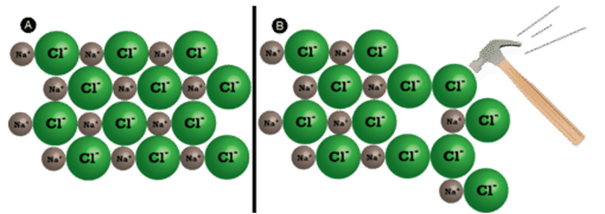
Malleability and Ductility
Why are metals malleable and ductile?
The sea of electrons allows for the bonds to shift without breaking unlike in an ionic bond.
Ionic
Metallic

Slide 9
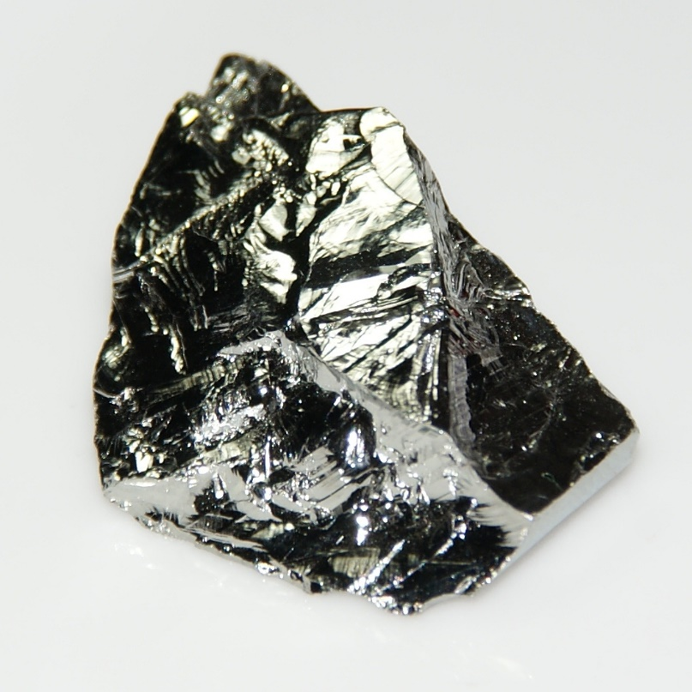
Shiny/lustrous
Metals are shiny because electrons are able to move from orbitals of different energy easily

Slide 10
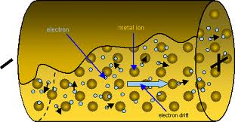
Shiny and Conductivity
Metals are good conductors of electricity because the electrons can move freely through the material creating an electric current
Metals are good conductors of heat because the electrons can move/vibrate easily

Slide 11
Alloys (don’t need to write)
What is an alloy?
Alloys are mixtures composed of metals though some can contain other types of elements.
Why do we use alloys?
Alloys are important because their properties can be different and are often superior to those of their component elements.
An example would be stainless steel because it does not rust

Slide 12
Essential Questions
What is metallic bonding?
What is a sea of electrons?
How do metallic bonds achieve the octet rule?
What properties do metals have?
Why do metals have the properties they do?

Slide 13
4.2 Tracked Assignment
worksheet

