Slide 1
4.3 Covalent Bonding Objectives 1:a-c,h-l,o; 2
Chemistry

Slide 2
Essential Questions
What is a covalent bond?
How can you tell if two elements can form a covalent bond?
How does a covalent bond fulfill the octet rule?
What is a molecule?
What are the properties of molecular compounds?
How are Lewis Structures drawn?

Slide 3
Covalent Bonding
A covalent bond is when valence electrons are shared between two nonmetals.
By sharing electrons each element in the covalent bond gets a full valence fulfilling the octet rule
A covalent bond forms when atoms have a relatively small difference in electronegativity so the electrons spend time with both atoms.

Slide 4
Covalent Bonds (cont)
Classify the following as ionic or covalent
CuCO₃
Ti₂S₃
NH₃
BaI₂
C₆H₁₂O₆
Ionic
Ionic
Covalent
Ionic
Covalent

Slide 5
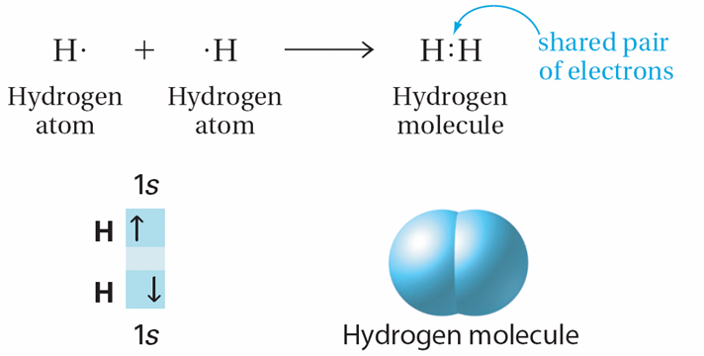
Covalent Bonds (cont)
Two hydrogen atoms would share a pair of electrons forming a single covalent bond so that both atoms have a full valence shell

Slide 6
Covalent Bonds (cont)
Single bond: One shared pair of electrons
Double bond: Two shared pairs
Triple bond: Three shared pairs
Double and triple bonds form when an atom needs to share additional electron pairs to become like a noble gas
Triple bonds are the strongest and the shortest

Slide 7
Molecular Compounds
A molecule is a neutral group of atoms held together by covalent bonds.
A molecular or covalent compound is a compound made up of molecules.

Slide 8
Molecular Compounds (cont)
Properties of molecular compounds:
Low melting and boiling points
Are not brittle
Do not conduct electricity in solution or individually
Insoluble or very low solubility in water (doesn’t dissolve well)
Some of them smell

Slide 9
Formulas
Molecular compounds can have their formula written out two different ways: molecular and structural
Molecular formulas are chemical formulas for molecules and show what atoms make up a molecule
Structural formulas show how the atoms are bonded and are done using Lewis structures

Slide 10
Strategy for Building Molecules
Step #1: Look up valence e⁻ for each atom and add them up
Hydrogen cyanide (HCN)
H → 1
C → 4
N → 5
10 Total Electrons
For anions add the number only from the charge to the e⁻ total
For cations subtract number only from the charge from the e⁻ total

Slide 11
Step #2
Start by adding single bonds between atoms
The least electronegative element (typically farthest from F) goes in the center
Except C always goes in the center and H never does.
H C N

Slide 12
Step #3
Add electron dots around each atom so it has a full set of valence electrons
Each atom surrounded by 8 electrons
Bond lines count as 2 electrons
NOTE: Hydrogen only wants 2 max
Boron usually only wants 6
H C N

Slide 13
Step #4
Add up electrons to see if they match the number calculated in step 1.
H C N
Do not need to redraw picture
14 electrons, can only have 10 e⁻
If number matches, you’re done
If it does not move to next step.

Slide 14
Step #5 Try a double bond
Next try another double bond or a triple bond
Unshared pair are electrons that are not involved in a bond
H C N
Unshared pair of electrons

Slide 15
HONC rule
HONC is a way to remember how many bonds each type of atoms usually needs based on valence electrons
Hydrogen and Halogens– 1 bond
Oxygen’s group -2 bonds
Nitrogen’s group -3 bonds
Carbon’s group - 4 bonds
Try CO₂ on your own.

Slide 16
Lewis Structures
Draw Lewis structures for the following:
H₂O
AsH₃
CCl₂H₂
NO₂⁻

Slide 17
Essential Questions
What is a covalent bond?
How can you tell if two elements can form a covalent bond?
How does a covalent bond fulfill the octet rule?
What is a molecule?
What are the properties of molecular compounds?
How are Lewis Structures drawn?

Slide 18
4.3 Tracked Assignment
Worksheet

