Slide 1
5.2 Molecular Polarity Obj 2
Chemistry

Slide 2
Essential Questions
What is a polar molecule?
How do you determine if a molecule is polar?
How does polarity affect solubility?

Slide 3
Polarity of A Molecule
A polar molecule has one end of molecule that is negative and one end that is positive from unequal e⁻ distribution
The negative and positive end is called a dipole
Polarity of a molecule depends on shape and type of bond, but must contain at least one polar bond

Slide 4
Polarity of A Molecule (cont)
A molecule will be polar if there is a dipole (both positive and negative end) on the molecule
Water has a the negative end (O) and a positive end (H’s)

Slide 5
Polarity of A Molecule (cont)
A molecule can be nonpolar with polar bonds if the molecule does not have a dipole so it does not have both positive and negative end.
Carbon dioxide has only negative ends

Slide 6
Determining Polarity of a Molecule
Write the Lewis Structure in the correct shape
Label polar bonds with arrows/symbols. If there are no polar bonds then it is nonpolar. If there are polar bonds go to step 3.
Check to see if the molecule has both a positive and negative end. If so it is polar and if not it is nonpolar.

Slide 7
Determining Polarity of a Molecule (cont)
Determine if the following molecules are polar
Ammonia: NH₃
Methane: CH₄
H₂S
SiCl₄
SeCl₆
GeSH₂

Slide 8
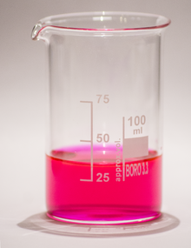
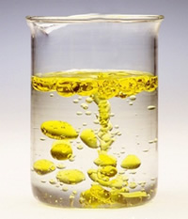
Solubility
Solubility is when two compounds are able to mix together or be dissolved
Insolubility is when they do not mix
Soluble Insoluble

Slide 9
Why does polarity matter?
Polarity affects solubility or how substances mix.
“Like dissolves like”
Nonpolar will only mix with nonpolar substances and polar with polar substances

Slide 10
Essential Questions
What is a polar molecule?
How do you determine if a molecule is polar?
How does polarity affect solubility?

Slide 11
5.2 Tracked Assignment
5.2 Tracked Assignment Worksheet

