Slide 2
5.3 Intermolecular Forces and Water Obj 3 and 4

Slide 3
Essential Questions
What are the different intermolecular forces?
How can you determine the type of intermolecular forces a molecule will have?
How do the strengths of intermolecular forces compare?
How does the type of force affect boiling/freezing points?
What are the special properties of water and why does it have those properties?

Slide 4
Intermolecular Forces vs. Intramolecular Forces
Intramolecular are atoms bonded together within a compound (Intra- means within)
Examples are ionic, covalent and metallic
Intermolecular forces are between entire molecules (inter means between)
Examples are hydrogen bonding, dipole-dipole and dispersion forces

Slide 5
Intermolecular Forces vs. Intramolecular Forces (cont)
Intramolecular forces are stronger than intermolecular forces because they involve sharing/transfer of electrons

Slide 6
London Dispersion Forces
London Dispersion Forces are forces from temporarily induced dipoles
Induced means “forced”
Polar negative and positive ends of one molecule force a temporary dipole on another molecule by pushing and pulling electrons
It is the weakest intermolecular force and all molecules have it

Slide 7
Dipole-Dipole forces
Recall: Polar molecules have partially positive end and partially negative end
Positive ends of one molecule are attracted to negative ends of another molecule (like poles on a magnet)
Stronger than London Dispersion Forces and only for polar molecules

Slide 8
Hydrogen bonding
A special type of attraction between molecules containing H bonded to F, N, or O
Hydrogen of one molecule is attracted to Nitrogen, Oxygen, or Fluorine of another molecule
It is NOT a covalent bond and is just a strong intermolecular force
Strongest intermolecular force
Water has strong hydrogen bonding

Slide 9
Hydrogen bonding in water

Slide 10
Identifying Intermolecular Forces
Type of IMF | Type of molecule that experiences this type of forces | Relative strength (rank weakest to strongest)
Dispersion Forces | All molecules | Weak
Dipole-Dipole | Polar molecules | Medium
Hydrogen Bonding | Molecules with H-F, H-N, and H-O bonds | Strong

Slide 11
Identifying Intermolecular Forces (cont)
Identify the intermolecular forces for the following:
PH₃
NH₄⁺
CH₂O

Slide 12
Boiling Points
For a liquid to become a gas it must overcome the intermolecular force(s) that are holding the particles together.
The stronger the intermolecular force(s) the greater the attraction between the molecules so it requires more energy to break the particles apart.
Stronger intermolecular forces result in a higher boiling point.

Slide 13
Boiling Points (cont)
Compare the following H₂O boiling point is 100°C and H₂S is -60.3°C
Why is there such a big difference?
The greater intermolecular forces from water having hydrogen bonding results in a higher boiling point.
Which would have a higher boiling point: CH₂O or BH₃?

Slide 14
Solubility
Substances will only be soluble or miscible when they have similar intermolecular forces
Oil and water do not mix because oil only has dispersion forces while water has all three forces so the water is more attracted to itself than it is to the oil.

Slide 15
Density of ice vs water
When water freezes it makes a honeycomb pattern which causes the water molecules to spread out because of hydrogen bonding.
This is the reason why ice is less dense than water

Slide 16
Surface Tension
Surface tension is the inward force, or pull, that tends to minimize the surface area of a liquid.

Slide 17
Surface Tension (cont)
Water’s surface tension is higher than most liquids due to its strong attraction to itself from hydrogen bonding.
Surface tension is why belly flops hurt and if you hit water from a great enough height it is like hitting concrete.

Slide 18
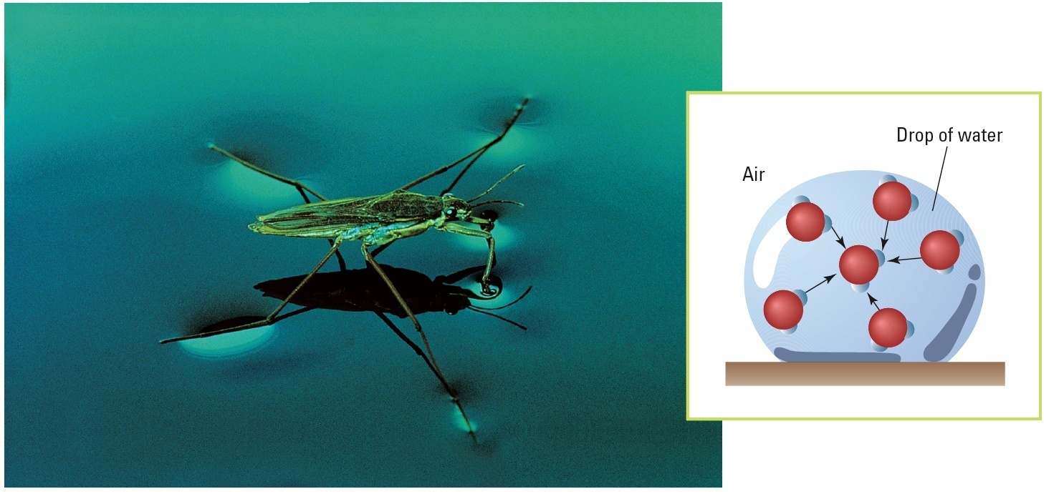
Surface Tension (cont)
Surface tension makes it possible for this water strider to walk on water.
Notes:
Surface tension makes it possible for some insects, such as this water strider, to walk on water. Water molecules at the surface of the water drop above cannot form hydrogen bonds with air molecules, so they are drawn into the body of the liquid, producing surface tension.

Slide 19
Adhesive and Cohesive Forces
Water has strong adhesive and cohesive forces because of its hydrogen bonding
Cohesive force is the attraction between all the water molecules.
Adhesive force is the attraction between the water molecules and other substances.

Slide 20
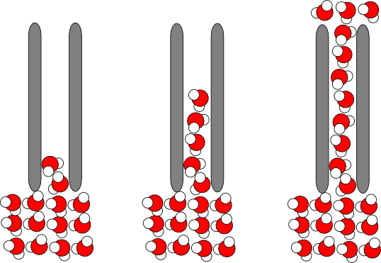
Capillary action
Water can “climb” up thin tubes or porous surfaces because the adhesive force is stronger than the cohesive force which allows the water molecules to pull each other up a surface

Slide 21
Essential Questions
What are the different intermolecular forces?
How can you determine the type of intermolecular forces a molecule will have?
How do the strengths of intermolecular forces compare?
How does the type of force affect boiling/freezing points?
What are the special properties of water and why does it have those properties?

Slide 22
5.3 Tracked Assignment
5.3 Tracked Worksheet

