Slide 1
6.4 Chemical Reactions Obj 2
Chemistry

Slide 2
Essential Questions
What are the parts of a chemical equation?
Why does an equation need to be balanced?
How can you tell if an equation is balanced?
How do you balance a chemical equation?

Slide 3
Chemical Reactions
A chemical reaction is when new substance(s) are formed through the rearrangement of atoms.

Slide 4
Why do reactions occur? (don’t need to write)
Reactions occur to reach a more stable state.
Fulfilling the octet rule
Reach a more stable energy level

Slide 5
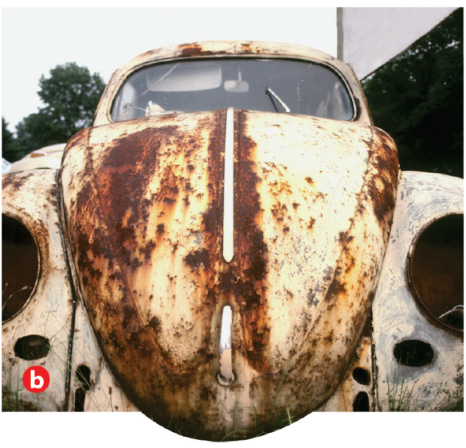
Chemical Equations
Representation of a chemical reaction
Reactants → Products
→ means “produces”, “forms”, “yields” etc.

Slide 6
Types of Chemical Equations
Word equations list the names of reactants and products
Iron metal reacts with oxygen gas to produce iron (III) oxide
Formula equations use chemical formulas to represent reactants and products
4 Fe (s) + 3 O₂ (g)→ 2 Fe₂O₃ (s)

Slide 7
States in Formula Equations
Letter in parenthesis indicates state
(s) solid
(l) liquid
(g) gas
(aq) aqueous solution (dissolved in water)

Slide 8
Law of Conservation of Mass (Conservation of Matter)
Mass cannot be created or destroyed; can only change forms
All chemical reactions and equations must be balanced to obey this law

Slide 9
Law of Conservation of Mass (cont)
The total mass (grams) must be the same on both sides of the equation
Ex: 2 H₂ + O₂ → 2 H₂O
4.04 g H₂ + 32.00 g O₂ → 36.04 g H₂O
Ex: HCl + RbOH → H₂O + RbCl
36.46 g 102.48 g 18.02 g ?
Ex: 2 Na + 2 H₂O → 2 NaOH + H₂
91.96 g 72.08 g ? 4.04 g
120.92 g RbCl
160 g NaOH

Slide 10
Law of Conservation of Mass (cont)
The number of atoms of products and reactants must be equal to one another to be balanced and follow the Law of Conservation of Mass

Slide 11
Identifying Balanced Chemical Equations
Identify if the following equations are balanced.
H₂ + O₂ → H₂O₂
MgS + HCl → H₂S + MgCl₂
NaHCO₃ + H₂SO₄ → Na₂SO₄ + CO₂ + H₂O
CH₄ + 2 O₂ → CO₂ + 2 H₂O
MgO + H₂O → Mg(OH)₂
H₂SO₄ + Fe(OH)₃ → Fe₂(SO₄)₃ + H₂O
balanced
unbalanced
unbal
balanced
balanced
unbalanced

Slide 12
Balancing Steps
Write equation with correct symbols and formulas.
Count the number of atoms of EACH type of element on each side of the arrow to see if it is balanced.
If unbalanced then balance atoms (one at a time) using coefficients (NEVER change the subscripts of a formula, or insert numbers within a formula)
Check your work to make sure the sides are equal. Coefficients should be the lowest possible whole number ratio.

Slide 13
Tips for Balancing
Leave single elements until the end to balance
If water is involved balance H and O at the end
Polyatomic ions can be counted like an element when on both sides
Elements that naturally exist with subscripts of 2 when alone are BrINClHOF

Slide 14
Sample Problem
Zn + HCl
(Not Balanced)
2
ZnCl₂ + H₂
Adjust the coefficients NOT the subscripts.
1
-Zn-
1
2
-H-
2
2
-Cl-
2
Balanced

Slide 15
Practice Problems
Na₂O + H₂O → NaOH
Mg + O₂ → MgO
CuSO₄ + Al → Al₂(SO₄)₃ + Cu
C₂H₄ + O₂ → CO₂ + H₂O

Slide 16
Practice Problems (cont)
Na₂SO₄ + KCl → NaCl + K₂SO₄
Ca₃(PO₄)₂ + AgNO₃ → Ca(NO₃)₂ + Ag₃PO₄
Zn(C₂H₃O₂)₂ + HBr → ZnBr₂ + HC₂H₃O₂
Au₂(CrO₄)₃ + Rb₃PO₄ → Rb₂CrO₄ + AuPO₄

Slide 17
Essential Questions
What are the parts of a chemical equation?
Why does an equation need to be balanced?
How can you tell if an equation is balanced?
How do you balance a chemical equation?

Slide 18
6.4 Tracked Assignment
Worksheet

