Slide 1
Physical and Chemical Changes and Properties

Slide 2
Essential Questions
How can you tell if something is a physical or chemical property?
How can you tell if something is a chemical or physical change?
What are the 4 indications of a chemical change?

Slide 3
Matter (don’t need to write)
Matter is anything that has mass and volume
Matter generally has 3 states or phases:
Solid: Has both definite shape and volume
Liquid: Has a definite volume but no definite shape
Gas: Has no definite shape or volume

Slide 4
Particle Arrangements (don’t need to write)
Gas particles have no regular arrangement and move/vibrate freely
Liquid particles are close together with no regular arrangement and can vibrate and slide past each other
Solid particles are tightly packed (usually in a regular pattern) and vibrate only.

Slide 5
Properties of Matter
A property is a trait or characteristic
There are two main types of properties in chemistry: physical and chemical

Slide 6
Properties of Matter (cont)
PHYSICAL PROPERTY- observed without altering the substance’s chemical identity
Examples of physical properties are:
Color
Density
Brittleness
Melting point and boiling point

Slide 7
Properties of Matter (cont)
CHEMICAL PROPERTY- observed when altering the substance’s chemical identity
Some examples are:
Reactivity
Combustibility
Rusting

Slide 8
Chemical vs Physical Changes
Label the following as chemical or physical properties
Silver melts at 961.78 °C
Oil is flammable
Iron rusts
Water has a density of 1 g/mL
An apple is red
phys
chem
chem
phys
phys

Slide 9
Changes in Matter
PHYSICAL CHANGE- does not alter the identity of a substance
State changes, changes in amount or size, dissolving
CHEMICAL CHANGE- does alter the identity of a substance
Flammability, ability to rust
Often called a CHEMICAL REACTION

Slide 10
Indications of Chemical Change
There are four indications of chemical changes or chemical reactions
Having an indication occur doesn’t automatically mean a chemical reaction happened it needs to be UNEXPECTED
For instance water freezing is a state change not a chemical change

Slide 11
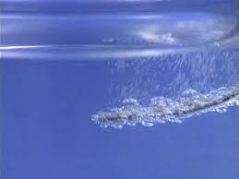
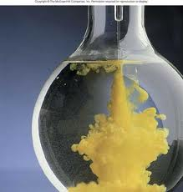
Indications of Chemical Change (cont)
a transfer of energy (light and heat)
color change
the production of a gas
the formation of a precipitate (solid).

Slide 12
Chemical vs Physical Changes
Identify if the following is a chemical or physical change
A purple powder is added to water and makes a purple solution.
A candle wick burning.
A liquid freezes into a solid.
Two liquids form a solid when mixed.
A piece of wood is being chopped.
phys
chem
phys
chem
phys

Slide 13
Essential Questions
How can you tell if something is a physical or chemical property?
How can you tell if something is a chemical or physical change?
What are the 4 indications of a chemical change?

Slide 14
Physical and Chemical Tracked Assignment
P 55 #28-29, 31-32
P 58-60 #53-54, 67, 69-71, 74

